Slide 1
Refactoring
…a brief introduction

Slide 2
What is Refactoring?

Slide 3
2ab + 14b + 5ab

Slide 4
2ab + 14b + 5ab

Slide 5
7ab + 14b

Slide 6
7b(a) + 7b(2)

Slide 7
7b(a+2)

Slide 8
What is Refactoring?
Usually a two-step dance:
Identify design/code that needs refactoring (code smells…)
Perform the refactoring
Often supported by tests:
Perform a refactoring operation
Run the test
If test OK, proceed to next refactoring
If test fails, roll back refactoring and reconsider…

Slide 9
Unit Test Structure
ARRANGE: Create scenario for this specific test
ACT: Perform the test (e.g. a single method call)
ASSERT: Compare expected and actual result of the test
SUCCESS
FAIL

Slide 10
What is Refactoring?
Code smells (examples from [MF:R])…
Duplicated Code
Shotgun Surgery
Large class (or God class)
Inappropriate Intimacy
Feature Envy
Comments (wut…?)
…

Slide 11
What is Refactoring?
Categories of smells (an attempt)…
Class Does Too Much
Class Does Too Little
Class Is Missing
Method Does Too Much
Code is WET (i.e. not DRY)

Slide 12
What is Refactoring?
Class Does Too Much
Large Class
Divergent Change
Feature Envy
Speculative Generality
Inappropriate Intimacy

Slide 13
What is Refactoring?
Class Does Too Little
Lazy Class
Middle Man
Incomplete Library Class
Data Class
Refused Bequest

Slide 14
What is Refactoring?
Class Is Missing
Shotgun Surgery
Data Clumps
Primitive Obsession
Switch Statement
Temporary Field

Slide 15
What is Refactoring?
Method Does Too Much
Long Method
Long Parameter List
Message Chain
Comments

Slide 16
What is Refactoring?
Code is WET (i.e. not DRY)
Duplicated Code
Parallel Inheritance Hierarchies
Alternative Classes with Different Interfaces

Slide 17
What is Refactoring?
Code smells (examples from [JK:RtP])…
Conditional Complexity
Indecent Exposure
Solution Sprawl
Combinatorial Explosion
Oddball Solution

Slide 18
What is Refactoring?
Refactoring operations (from [MF:R])…
Rename Method
Move Field
Move Method
Extract Method
Extract Class
Replace Temp with Query
Decompose Conditional
…and 50+ more

Slide 19
What is Refactoring?
Refactoring operations (towards patterns, from [JK:RtP])…
Replace Conditional Logic with Strategy
Unify Interfaces with Adapter
Replace Constructors with Creation Method
Move Accumulation to Visitor
Replace Implicit Tree with Composite
…and ~20 more

Slide 20
When to Refactor?
Example: Test-Driven Development (TDD)
The Red-Green-Refactor principle
Write a unit test for the code you are about to write
Run the unit test; it will (obviously) fail [RED]
Write the code itself, until the unit test passes [GREEN]
Perform refactorings on your code [REFACTOR]
BUT you can always refactor, even in more traditional development processes!

Slide 21
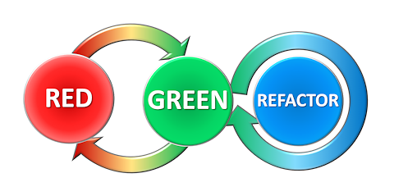

Slide 22
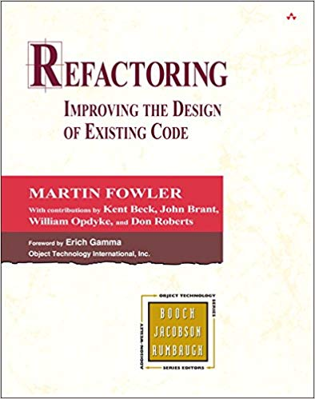
Refactoring books [MF:R]
The classic book on refactoring
Definitions of code smells, but no specific examples
From 2000, so examples a bit dated w.r.t. syntax (Java)….
ISBN: 0-201-48567-2

Slide 23
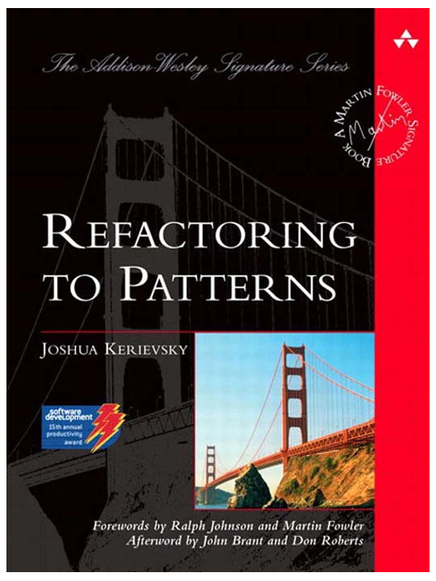
Refactoring books [JK:RtP]
Focuses more on larger-scale refactorings towards patterns
Also examples of refactorings away from patterns
Introduces a few new code smells as well
ISBN: 0-321-21335-1

